Slide 1
Attack on Titan (Shingeki no Kyojin) is a Japanese manga series written and illustrated by Hajime Isayama. It takes place in a world where humanity is on the brink of extinction due to gigantic humanoid creatures called Titans, who devour humans for reasons unknown. The story follows the journey of Eren Yeager, along with his friends Mikasa Ackerman and Armin Arlert, as they fight to survive and uncover the truth behind the Titans.
ATTACK ON TITAN

Slide 2
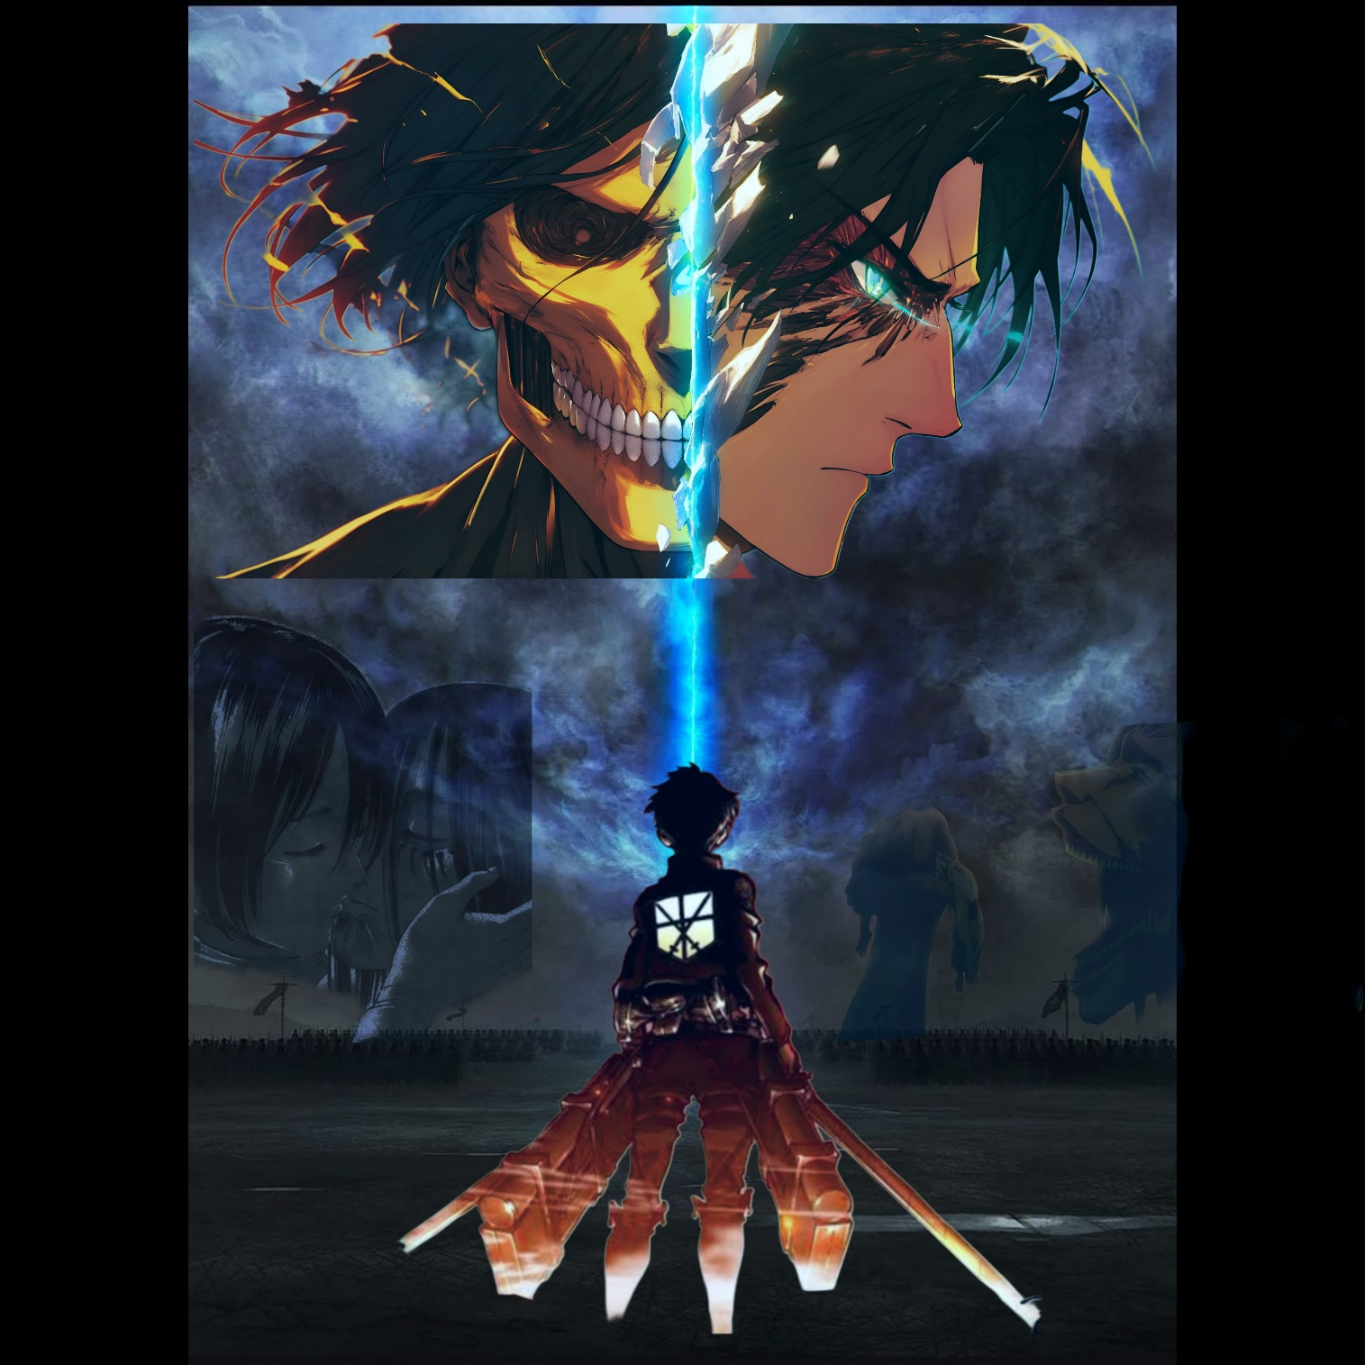

Slide 3
Summary of the Story:
The Setting:
The story begins in a world where the remnants of humanity live within enormous walled cities, protected from the Titans by three massive concentric walls: Wall Maria, Wall Rose, and Wall Sina. These walls keep the Titans out, but also restrict human freedom and knowledge about the outside world.
The Attack on Wall Maria:
The plot kicks off with the sudden appearance of the Colossal Titan, a gargantuan creature that breaches Wall Maria, allowing other Titans to invade and devastate the city. Eren Yeager, the protagonist, loses his mother in the attack, which propels his desire for vengeance against the Titans. Along with his adoptive sister Mikasa and their friend Armin, Eren joins the military to fight back against the Titans.
The Military and the Training:
Eren, Mikasa, and Armin undergo rigorous training to become Survey Corps members, elite soldiers who venture outside the walls to fight Titans. Eren is particularly motivated by a deep hatred for the Titans, believing he can somehow rid the world of them. During their training, they encounter various characters, including Levi Ackerman, an elite soldier and one of humanity's strongest warriors, and Erwin Smith, the determined leader of the Survey Corps.

Slide 4
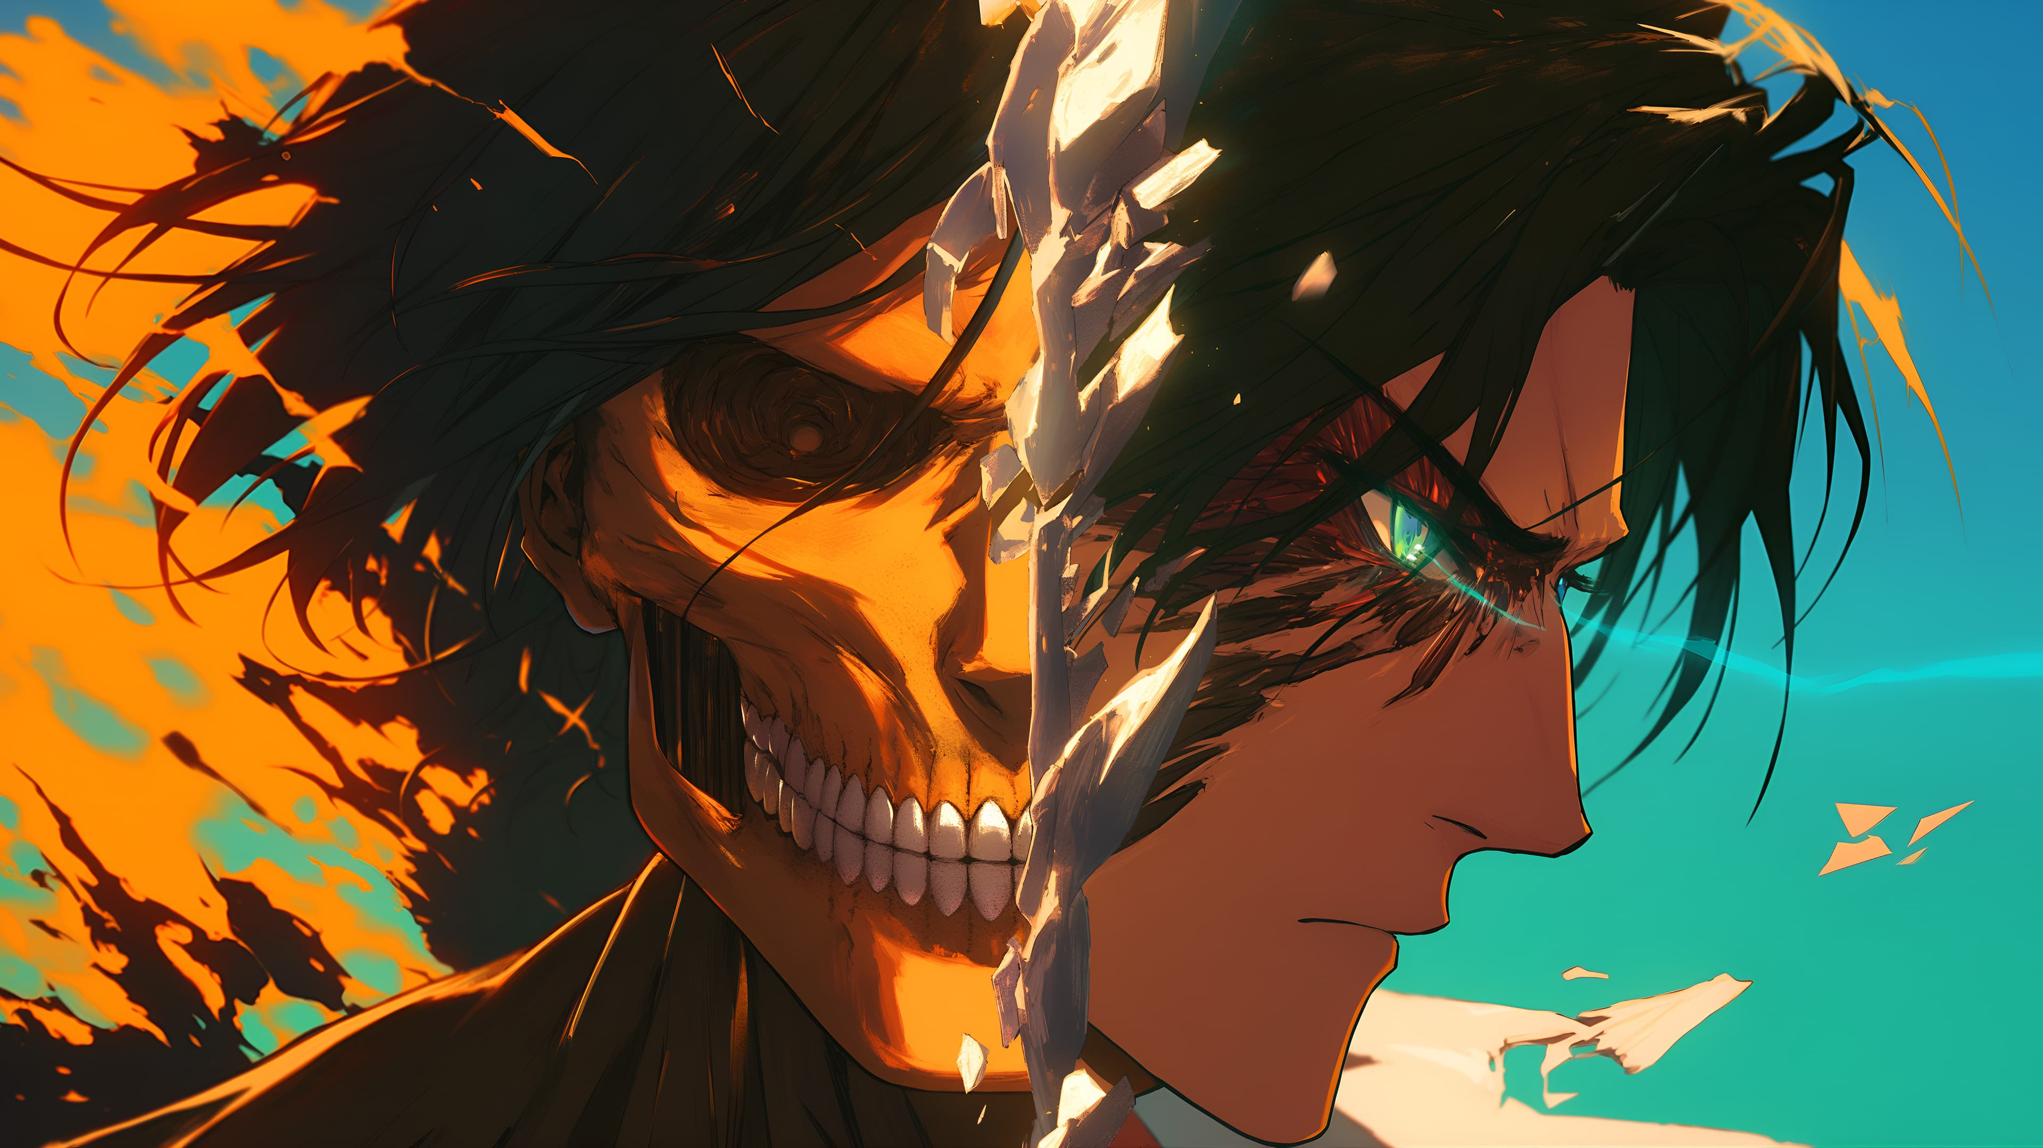

Slide 5
The Mystery of the Titans:
As the story unfolds, the trio uncovers secrets that question everything they know about the Titans. Eren discovers that he has the ability to transform into a Titan himself, which becomes crucial for humanity’s fight. This leads to the revelation that certain humans are capable of becoming Titans, and not all Titans are mindless creatures.
One key mystery is the existence of the Titan Shifters, humans who can transform into Titans while retaining their human consciousness. Eren himself becomes one of these Titan Shifters, a power he struggles to control at first but gradually learns to use in battle. Along the way, the group also learns about the Warriors, a faction of Titan Shifters who infiltrate humanity's ranks for a mysterious purpose.
The Truth Behind the Titans:
The discovery of an ancient underground library beneath the capital city reveals startling truths about the world’s history. The Titans are not just mindless creatures; they are connected to a conflict between two ancient factions: the Eldians and the Marlins. Eldians, who are able to inherit the power of the Titans, were once the ruling power in the world, but they were oppressed and betrayed by the Marlin Empire, who now controls the outside world.

Slide 6
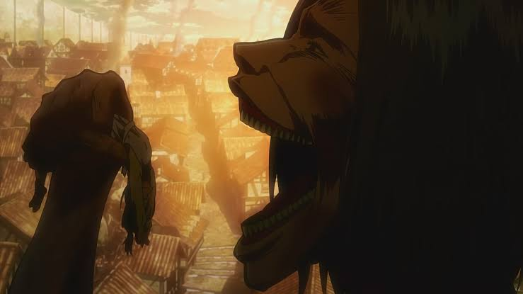

Slide 7
It is revealed that the Founding Titan, a legendary Titan, has the power to control all Titans and manipulate the memories of Eldians. The key to this power lies within the royal family, whose members possess the Founding Titan’s abilities. Eren and his friends uncover a hidden truth—that their world, trapped inside the walls, is not the entire world, and humanity has been kept ignorant by a long-standing conspiracy.
The War for Survival:
As the story progresses, Eren and his friends find themselves embroiled in larger political and military conflicts, including war with the Marlins and an exploration of the mysterious island of Paradise, where the Eldians were isolated. Eren's motivations shift over time as he learns more about the Eldian Restorationist movement and the Marlian oppression of his people. Eren's ultimate goal becomes the destruction of the Marlin Empire and the liberation of the Eldians, but his methods become increasingly extreme.
The Rumbling and the Endgame:
In the final arcs of the story, Eren initiates a catastrophic event known as the Rumbling, which involves unleashing the power of countless Colossal Titans hidden within the walls to cause worldwide destruction. Eren’s plan is to annihilate humanity outside of the island to protect the Eldians from future genocide. However, his friends, including Mikasa, Armin, and others, realize that Eren has gone too far and must be stopped to prevent total annihilation.

Slide 8
As the story reaches its climax, alliances are tested, and the true nature of freedom, survival, and sacrifice are explored. The survivors of the conflict are forced to confront the consequences of Eren's actions and decide what kind of world they want to rebuild.
The Ending:
The series concludes with the resolution of the conflict and the final battle between Eren and his former allies. The moral and philosophical questions that run throughout the series about freedom, violence, and the cyclical nature of hate are addressed. In the end, Eren's actions lead to both the destruction of the old world order and the birth of a new future for humanity, though not without great personal sacrifice.
Themes:
Attack on Titan explores themes of freedom, the cycle of hatred, the nature of war, and the ethics of survival. The series questions whether humanity is inherently doomed to repeat history, focusing on how power and fear shape societies and individuals. It also deals with the complexity of human emotions, relationships, and the consequences of choices made in the pursuit of survival.

